Slide 1
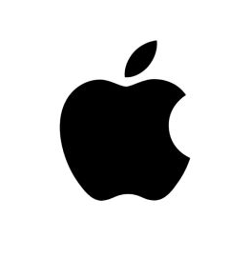
APPLE IN JAPAN
GROUP 5:
1155172707 Shuoyan HUANG
1155147304 Hans Nathanael JUNOES
1155172596 Jiamian TIAN
1155172587 Tianrun LIANG

Slide 2
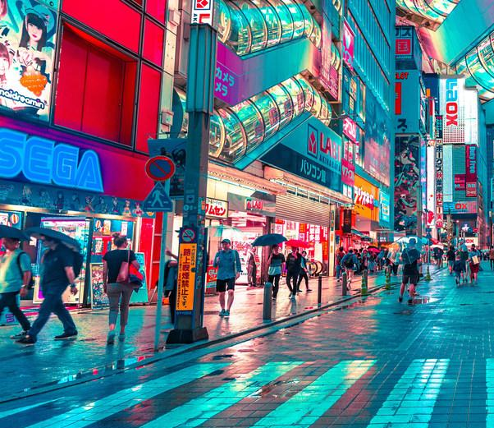
PART I - Economic of Japan
Third largest economy in the world in terms of Nominal GDP
Fourth largest in terms of purchasing power parity (PPP)
Second largest developed economy in the world
Statist market economy model
Low birth rate and aging - shortage of labour, difficulty to raise the level of consumption, deflation
FDI inflows are relatively low - investment market narrow

Slide 3

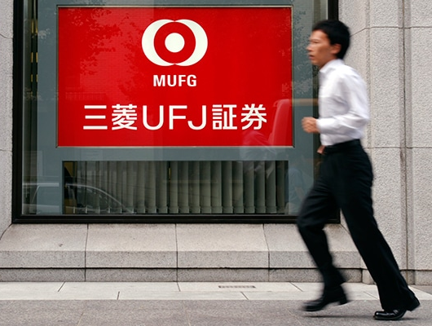
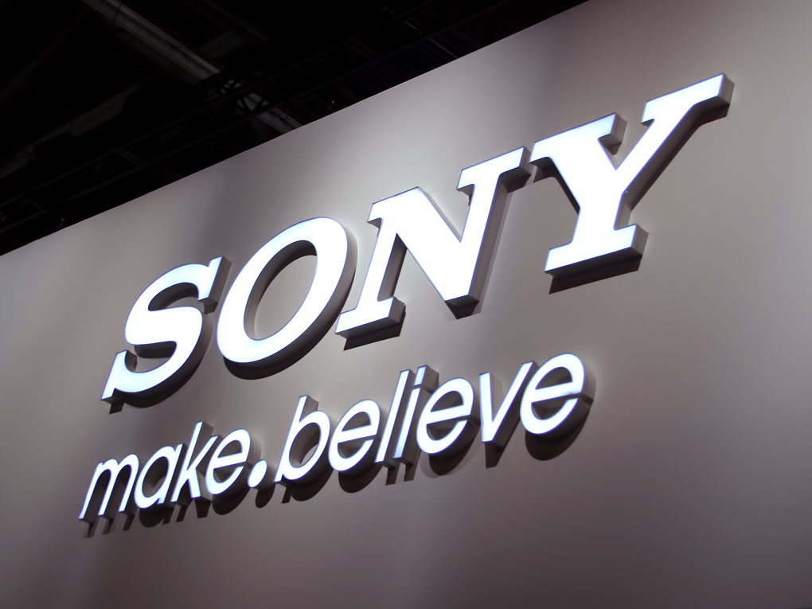

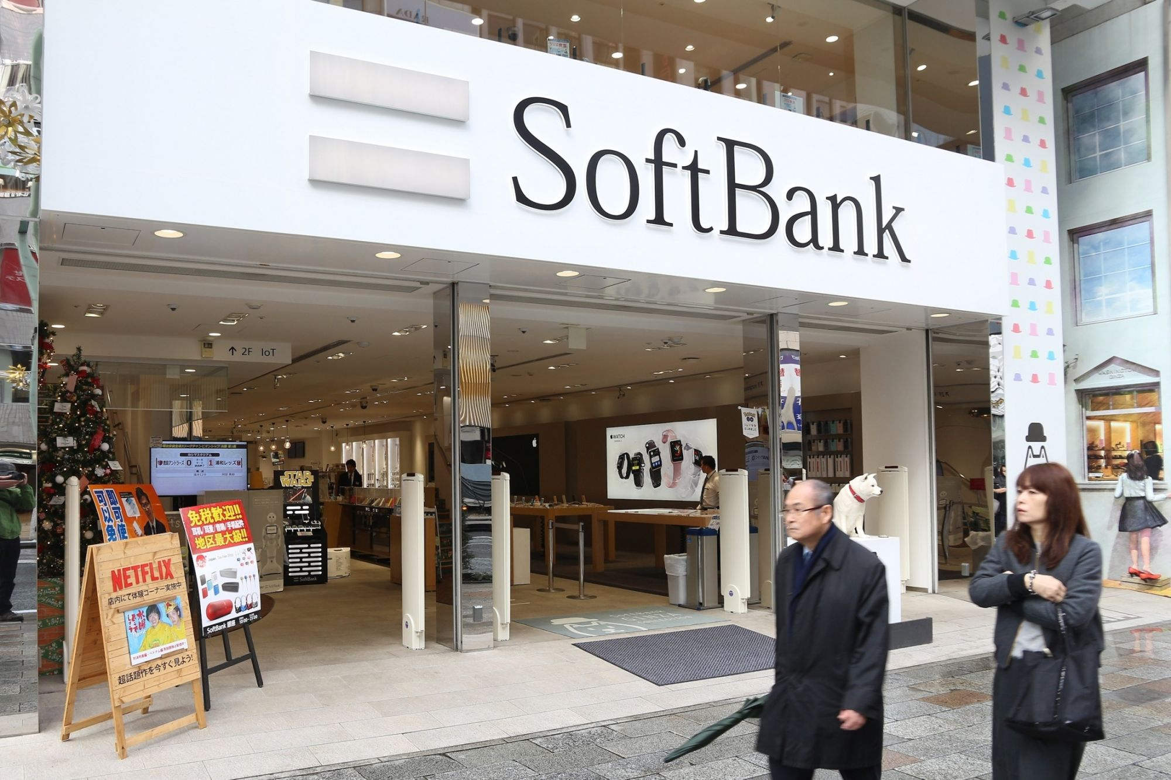
PART I - Economic of Japan
One of the major sources of global FDI outflows - mainly in the financial, communication and information communication sectors - world's largest creditor country.
Japan's Global Competitiveness Index ranked 6th in 2019 - well-developed infrastructure, stable macroeconomic development, high technology content - shortcomings: unsaturated labour markets
Japan’s leading companies include: Toyota Motor, Mitsubishi UFJ Financial, Nippon Telegraph & Tel, Sony, Nissan Motor, Softbank, etc.

Slide 4

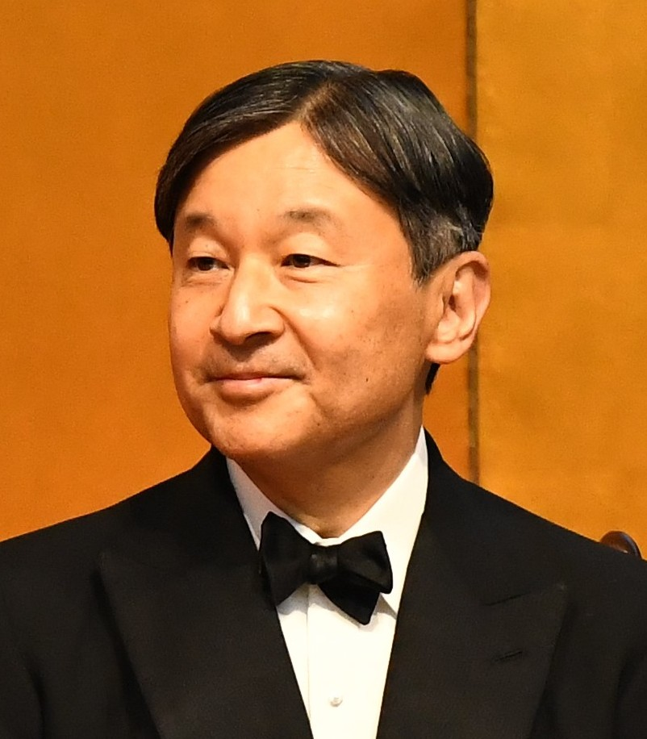
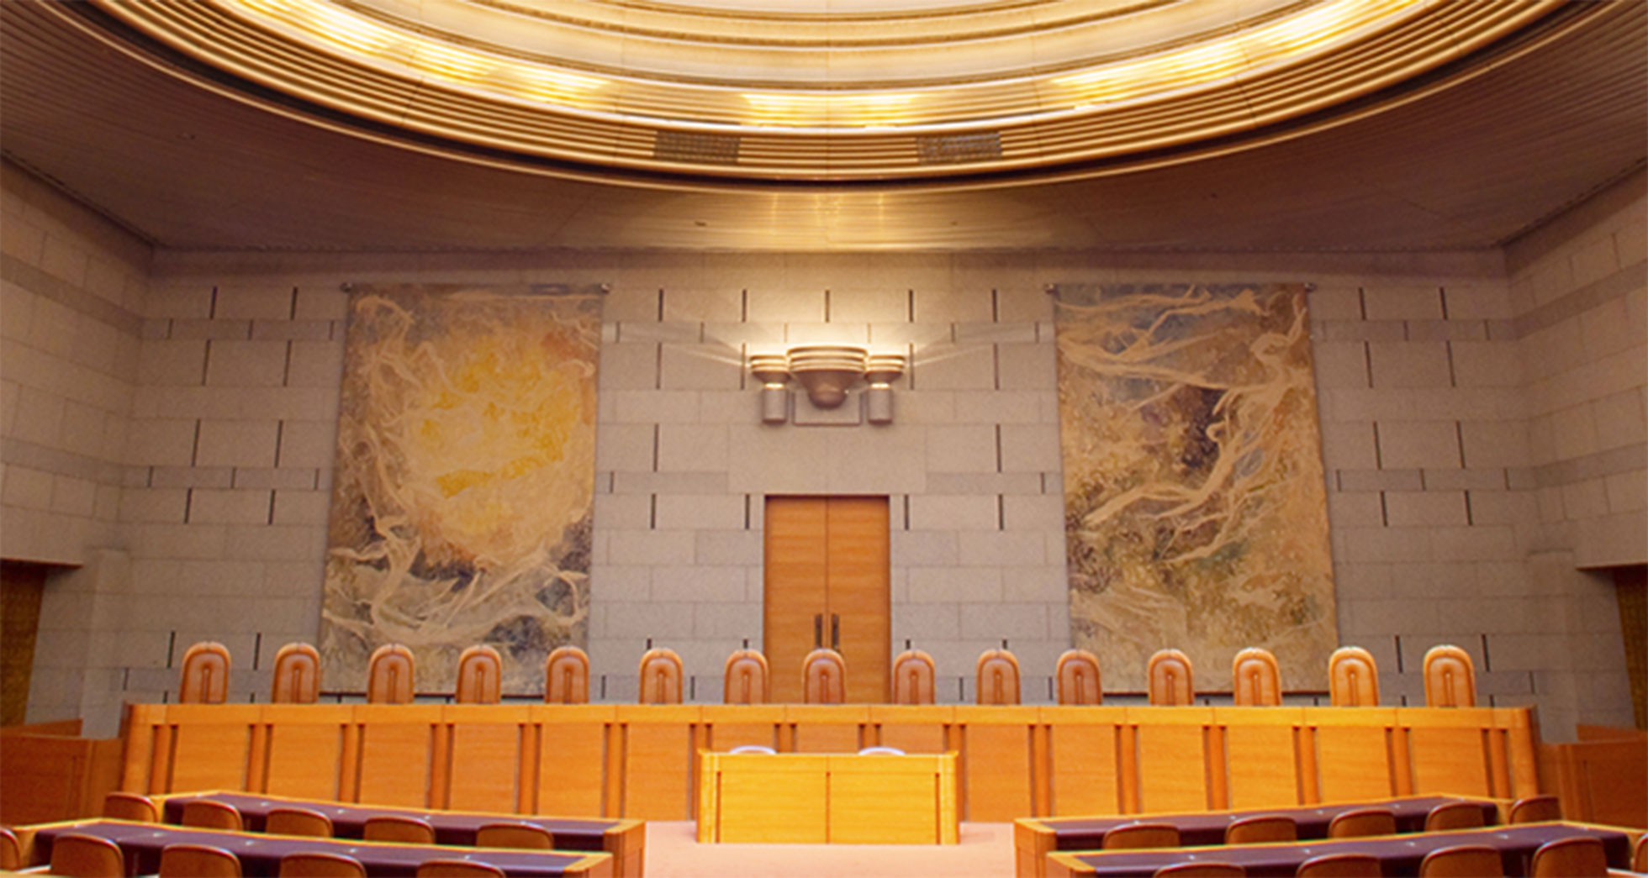
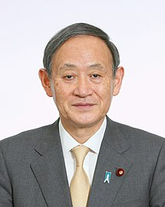
PART I - Politics of Japan(Parliamentary Constitutional Monarchy)
Naruhito
Emperor
(Chief of State)
National Diet
(Legislative)
Supreme Court
(Judicial)
Yoshihide Suga
Prime Minister
(Chief Executive)

Slide 5

PART I - Politics of Japan
World peace, prosperity, and freedom as core of Japan’s ideology
-> Japan’s very harsh history in World War
Close political and economic relations with neighbouring countries
-> Weak base of natural resources
96/100, top 25 most stable nation in 2019 and 5th most stable in Asia based on Freedom House
23rd most free country based on IEF
One of the most stable country politically

Slide 6
PART I - Politics of Japan
STRENGTHS :
Judiciary law is independent and fair
Protection for real and intellectual property
Government business regulations are efficient
Corruption is 19th lowest in the world
WEAKNESSES :
Tax burden is high(up to 40.8% for individuals income and 23.9% for corporates)
Huge government spending racking up 237.4% of GDP in debt

Slide 7
PART I - Cultural Environment of Japan
a) Japanese culture is a mixture of eastern culture and western culture.
b) From the 4th century to the 9th century, Japan has always been associated with east Asian culture. In recent years, While absorbing western culture, Japan maintains its cultural diversity.
c) From the Hofstede Explaining His Framework, High masculinity, Restraint, Uncertainty Avoidance, long term orientation and Restraint is obvious in Japan.
Specific Features：
• Power distance：Japan is a borderline hierarchical society which it gets an intermediate score of 54. Everyone is born equally in the Japanese education system.
• Individualism: Japanese people indicates characteristic of collectivism. They feel shame when their opinions break the harmony of group (Hofstede Insights 2021).

Slide 8
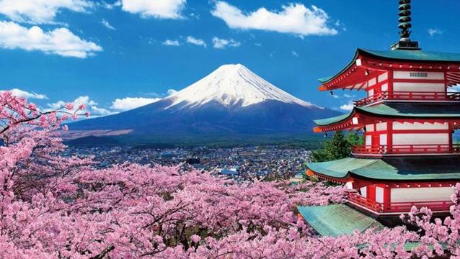
Specific features in Hofstede framework for Japan
•Masculinity: Japan is one of the most Masculine societies in the world. It is common that see a severe competition between groups.
•Uncertainty Avoidance：As unique location, Japan always faces earthquake, typhoons and other natural disasters. Japanese learned to prepare for any uncertain situation.
•Long-term orientation: Japan scores 88 means Japanese focus on future long-term orientation.
•Indulgence vs. Restraint: Japan have a culture of restraint. They are used to controling their desires. (Hofstede Insights 2021)

Slide 9
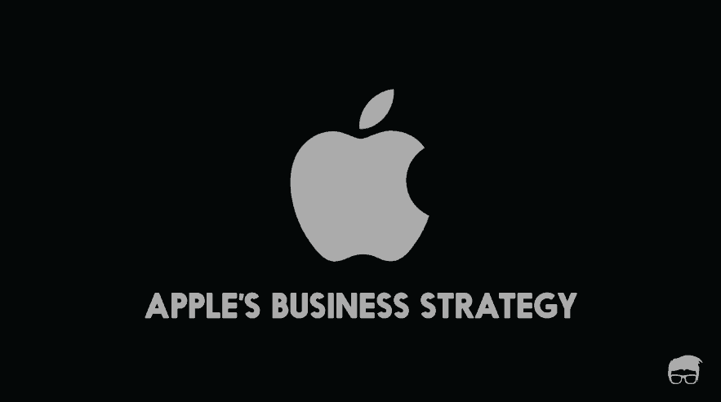
PART II - Strategy
We will briefly analyze the strategy of Apple from five aspects:
Industry
Products
Markets
Strategic positioning
Core competencies

Slide 10
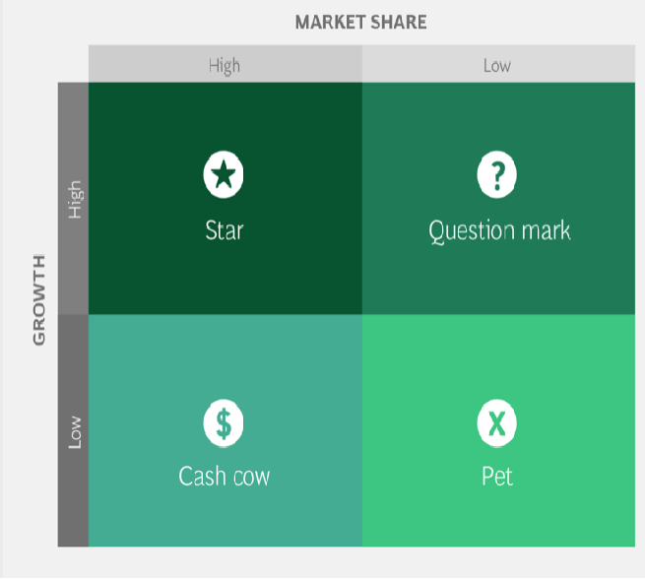
Industry
Arthur D Little (ADL) Matrix
Apple is committed to improving in the three industries - hardware, software and services.
Industry maturity - Mature Competitive position - Strong
Products
BCG Growth Share Matrix
Star: iPhone, iPad, Apple Watch
Cash cow: iTunes, MacBook, IMAC
Question mark: Apple TV, Airpods
Pet: iPods

Slide 11

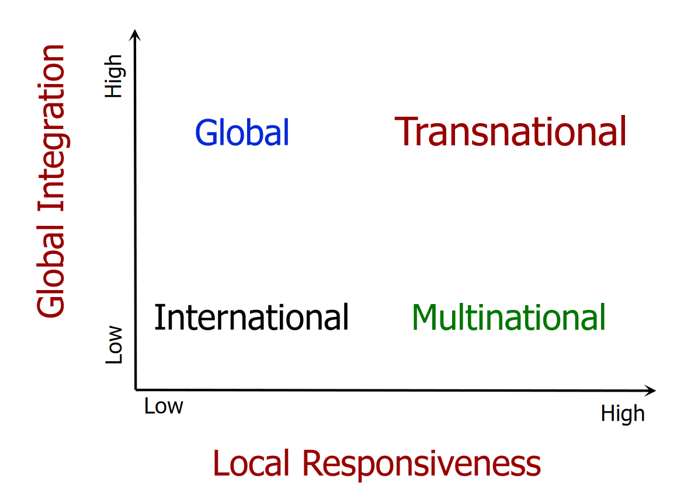
Markets
Blue Ocean Strategy
Apple has discovered new uncompetitive market spaces ahead of other companies.
Apple's typical representative in this strategy is iTunes
Apple uses the blue ocean strategy to eliminate competition and create new markets for new products
Strategic positioning
Global Strategy
Low local responsiveness and high global integration
Apple's products are universally available to people everywhere, and technology and services are common
Apple has been dominating the global layout at its core.

Slide 12

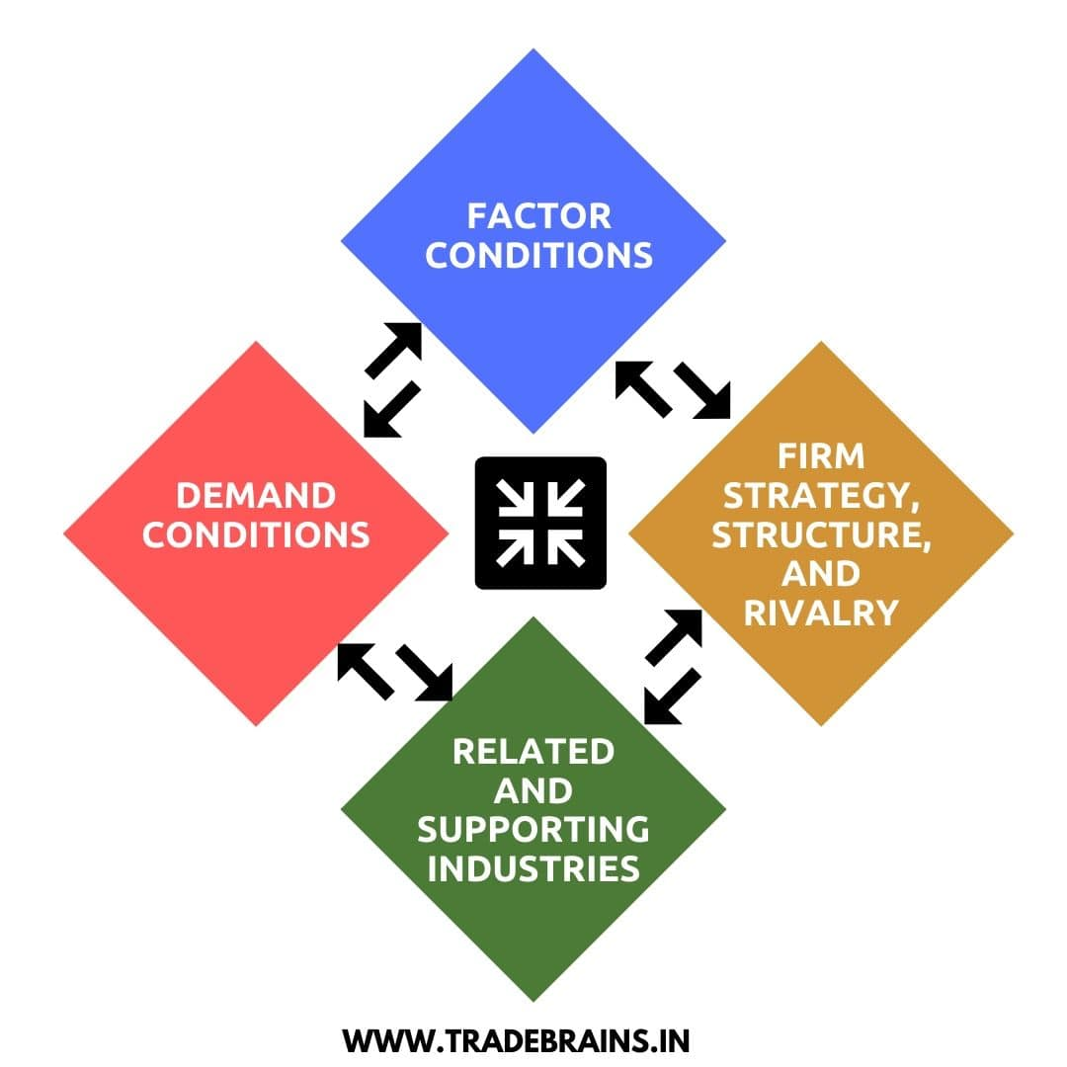
Core Competencies
Michael Porter’s “competitive advantage: creating and sustaining superior performance” strategy
Differentiation Strategy
This differentiation can be reflected in Apple's product design, pricing strategy, retail approach, and customer loyalty.
Porters Diamond Model
Factor conditions: financial resources, infrastructure, and technological innovation; a complete set of physical and technological networks
Demand conditions: predict patterns of consumer behavior in other similar countries based on Japan's consumer characteristics
Related and supporting industries: a strong global network of suppliers; retail stores in different regions
Firm strategy, structure and rivalry: Japan's fierce competition for homegrown electronics helps power Apple's technological innovation

Slide 13

PART II - Organization
What made Steve Jobs succeed?
Before Steve Jobs :
Relatively flat organization
Lots of models and product lines
Lots of distributors
General managers were common
After Steve Jobs:
Hierarchical and expertise-based functional structure
Few models and product lines
Several distributors
Lack of general managers

Slide 14
PART II - Organization
Structure :
Hierarchical + Matrix
International Division
Functional Structure : everyone is an expert at their roles
Senior Vice Presidents and Vice Presidents directly under CEO
Lower to middle levels of management has product divisions (weak matrix structure)
CEO is the only one controlling an entire process from development to sales (no general managers)

Slide 15
PART II - Organization
Why functional?
To remain competitive and innovative in the ever-changing market
Judgement and intuition of experts are crucial
Emphasis on long-term gains
Easier to achieve balance between value added and costs
Easier to achieve economies of scale
Expert-to-expert communication

Slide 16
PART II - Organization
Hierarchical and top-down
Hierarchical structure
Tight control
Clear lines of command
Opportunities for promotion
Top-down decision making
Centralized in HQ
CEO is the sole decision maker
Process involves collaborative debate
Fast to market

Slide 17
Apple company culture and composition of the top management team
PART II - People
Apple Value
1. Go for perfect and tap the expert
2. Be ruthless and focus on people
3. Never stop studying and simplify
4. Keep secrets and keep team small
5. Use more carrot than stick and prototype to the extreme
Apple Organization
zoning management according to local condition
Only CFO hold the ‘Income statement’
Employees could connect management apartment, Management staff could directly talk to CEO
Apple set ‘Direetly Responsible Individual (DRI)’. Each position has its own responsibilities.

Slide 18
Personnel solutions for international operations
PART II - People
International mentality：
Geocentric --world orientation(As Apple company has a huge market, it apply to zoning management to adapt measures to local conditions)
Solutions:
Apple company make different management plans for Japan. Latest News indicates over half staffs from Japan work at Apple. Apple hire local people to manage market and corporate with local carriers actively.
Role of country managers:
Country manage would use economic policy to keep country alive. As country managers in Japan, they could work under pressure and use innovative approach to lead team get success.

Slide 19

Challenges & Recommendations

Slide 20
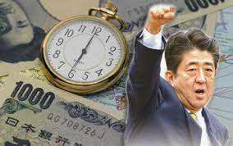
1
As Abenomics policy in Japan, Apple company only increase the price of product of Apple(Abenomics adopts expansionary policies and inflation rate increases). It could affect products of Apple sales in Japan.

Slide 21


2
Aging of the population in Japan
shortage of labour reduction of purchasing power level
Blue Ocean Strategy- Finding new markets -
Development of software and services for the elderly
For example: add more features to monitor health in Apple Watch, and coroperate with senior gyms

Slide 22
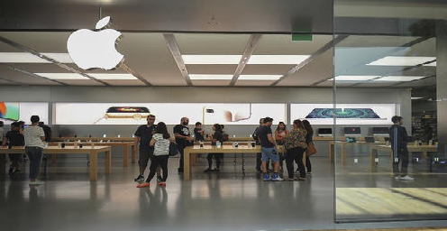
3
Alternative products gradually dominate the iPhone market

Slide 23
4
Focus too much on technological innovation rather than ultimately increasing the company's profits

Slide 24
5
Do not pay attention to the systematic management system

Slide 25
6
Involved in too many product categories

Slide 26

for listening!
~ Group 5

